Slide 1
Origami Tessellations Based Actuation
EGR557: Foldable Robotics
How can the directional stiffness exhibited by origami tessellations be used to simplify the actuation and locomotion of a laminate robot?
Bio-inspiration: ‘Rat’ Motion/Behaviour
-manufacturing constraints may necessitate a robot built at a slightly different scale
Team - Disha Vyas, Eric Feil, Manan Luthra,
Meet Shah, Dr. Dan Aukes (Advisor)
Project Update
Dynamics
Data Collection, Parameter Identification, and Model Fitting
Manufacturing
Future Plans

Slide 2
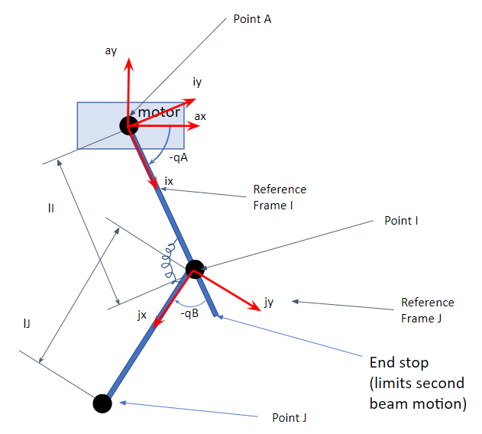

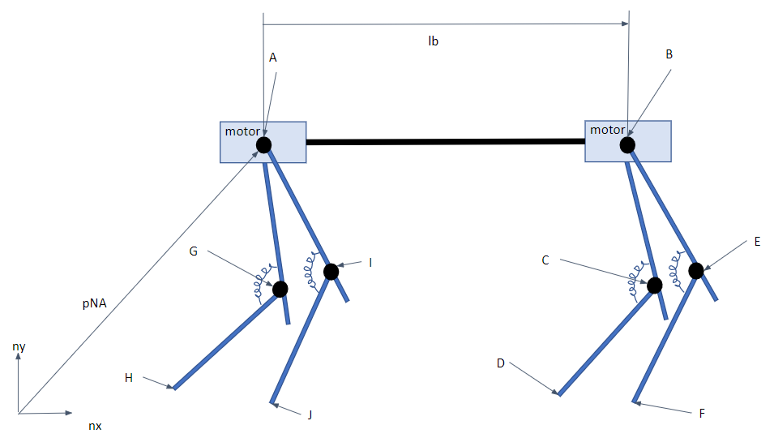
Dynamics
Coordinate Representation for a leg in Robot
Animation for System Dynamics
System Dynamics Representation for Robot
The beams will be modeled as rigid as their corrugated design gives them high stiffness until they buckle
To Be Added:
Motors
Motor control timings
Ground interactions
Fitted model parameters
Project Update
Dynamics
Data Collection, Parameter Identification, and Model Fitting
Manufacturing
Future Plans

Slide 3
Data Collection/Parameter Identification
Model Fitting
Leg joint
Tune leg model to match the video
Beams
Implement force checks to test if the beams will buckle and thus fail
Servo
Tune software motor force pid controller to match the servo video
Leg joint springiness/damping
Take video of the leg acting as a pendulum
Buckling loads for the beams
Attach corrugated section to table
Add mass to the far end of the beam until it buckles
Mass/inertial properties of laminate
Measure the mass of a known area of the laminate
Servo properties (including PID modeling)
Take video of the servo as it is commanded to change positions with a known mass attached
Project Update
Dynamics
Data Collection, Parameter Identification, and Model Fitting
Manufacturing
Future Plans

Slide 4
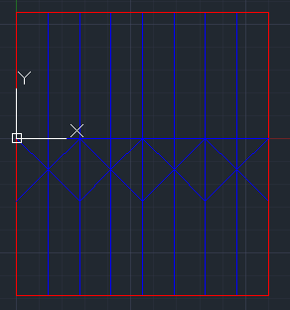
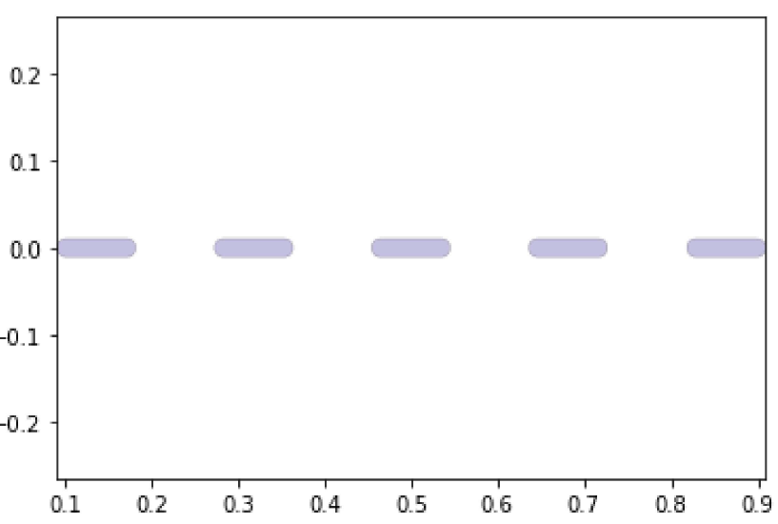
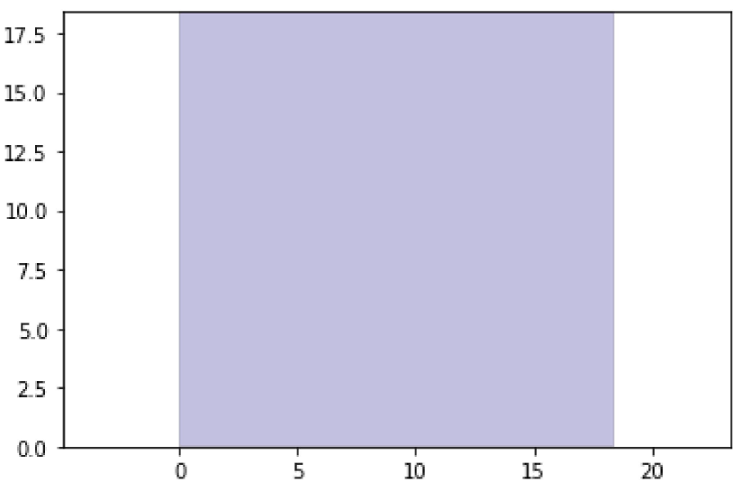
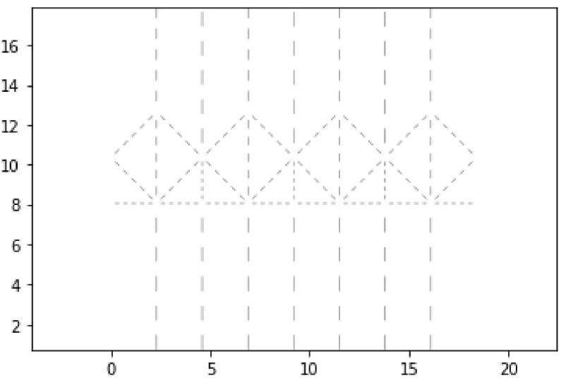
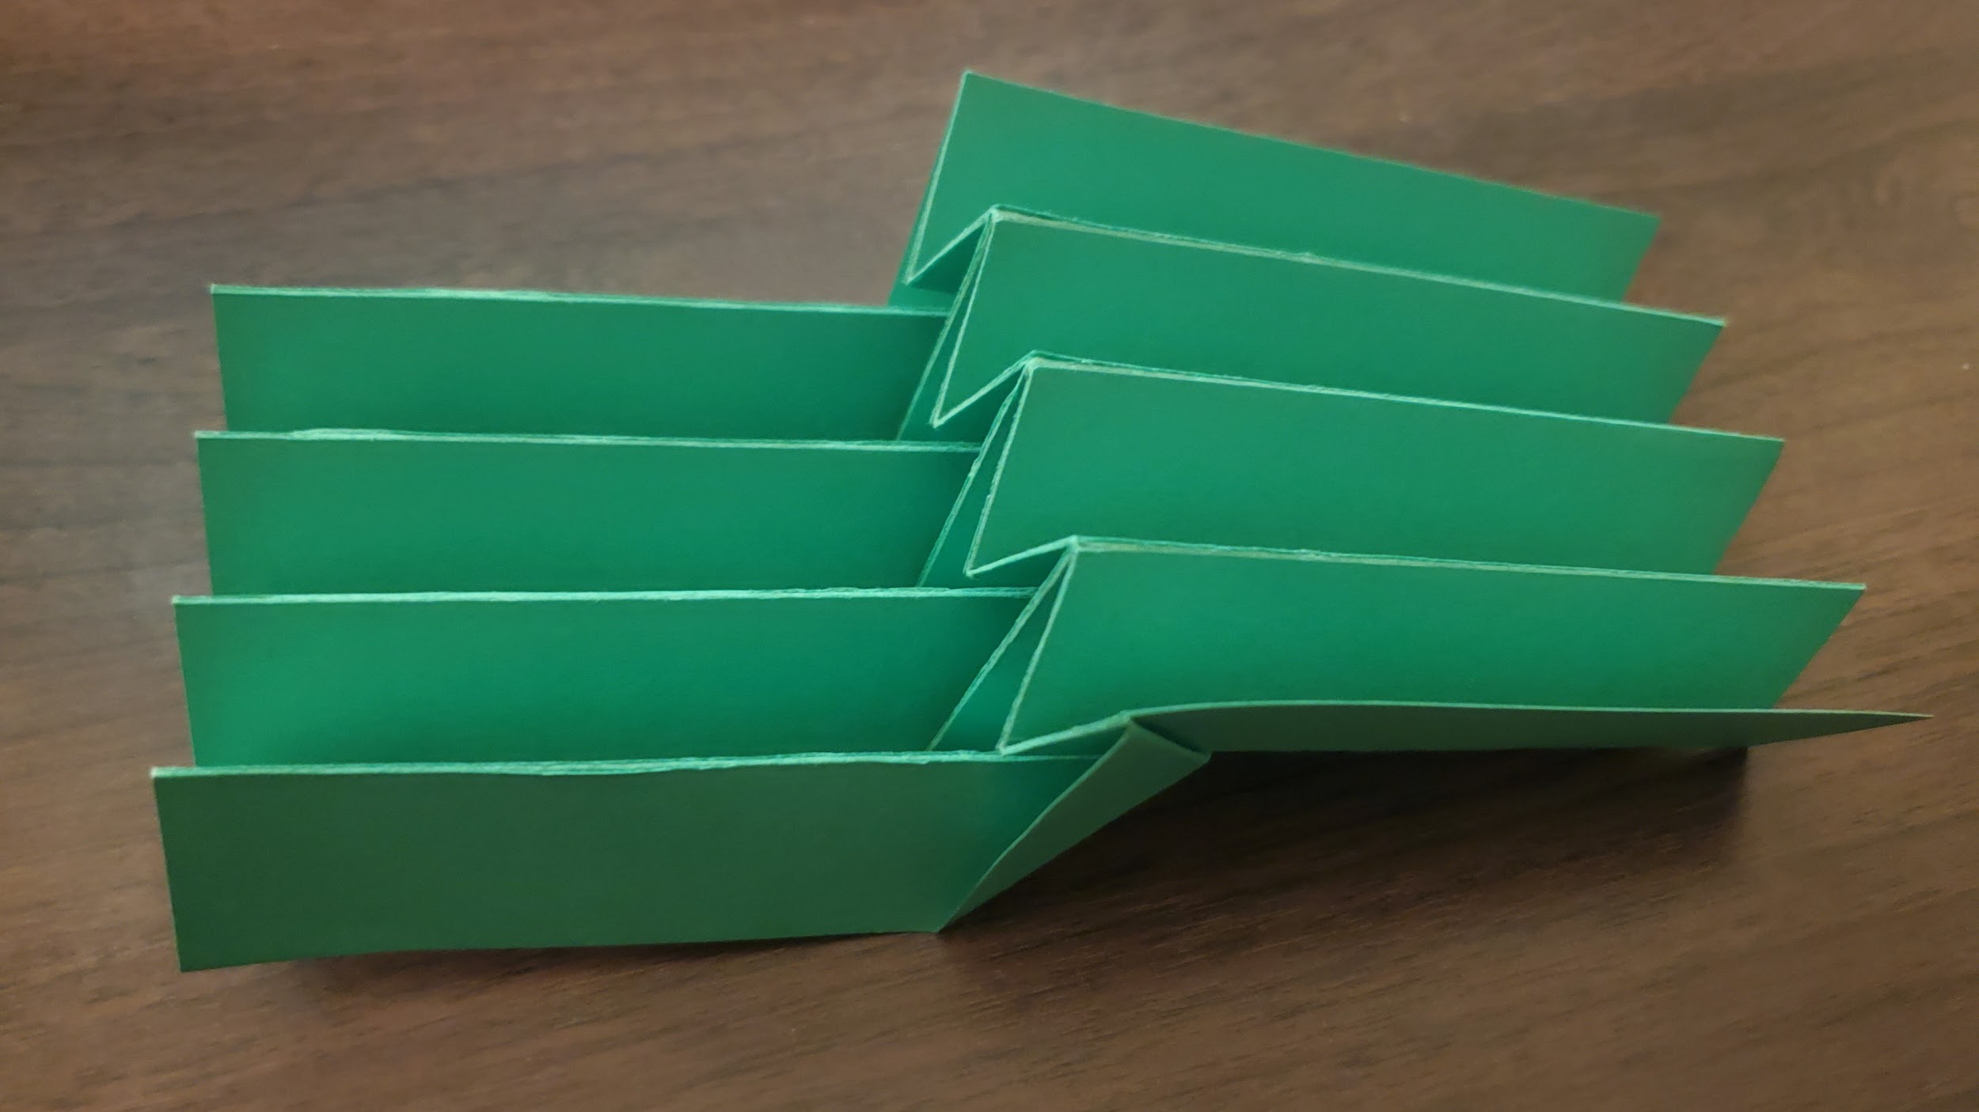
Manufacturing
Single Layer Design:
Project Update
Dynamics
Data Collection, Parameter Identification, and Model Fitting
Manufacturing
Future Plans

Slide 5
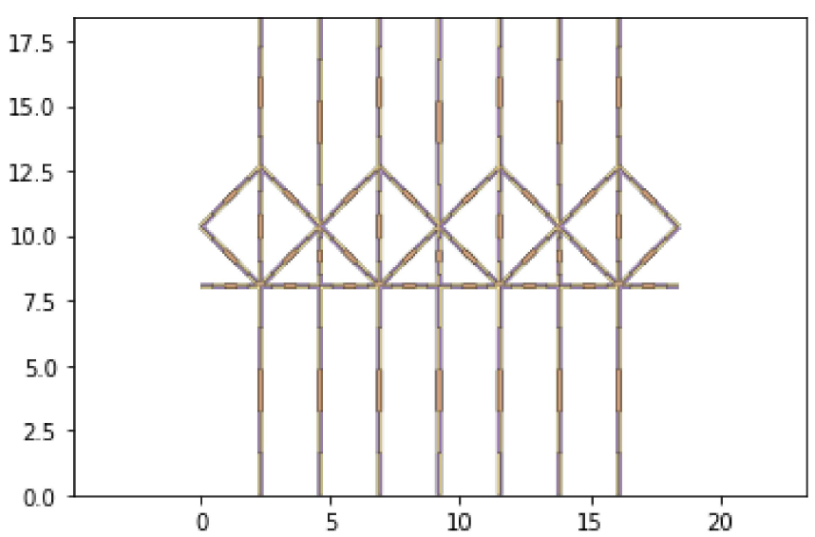
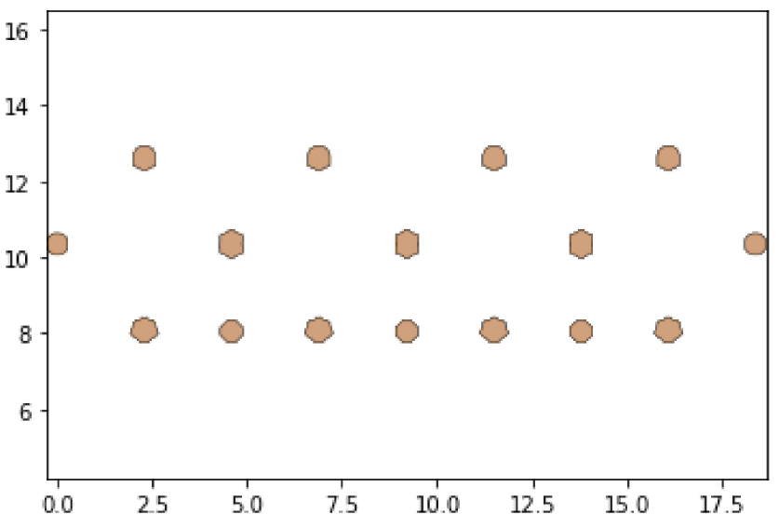
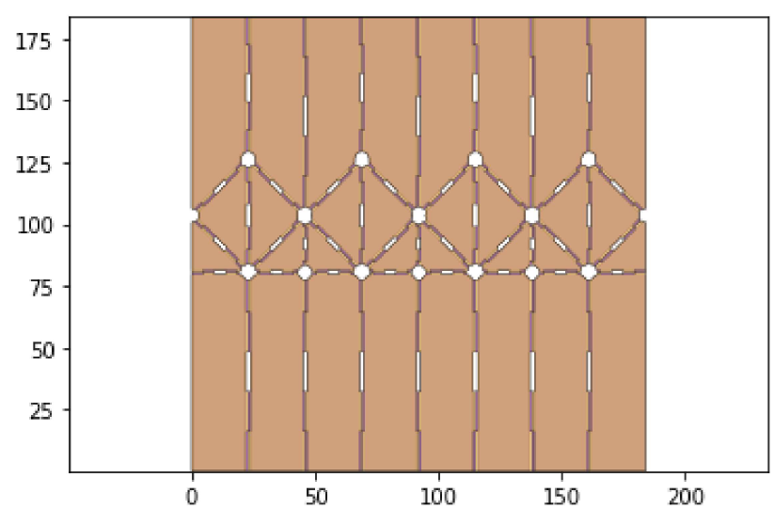
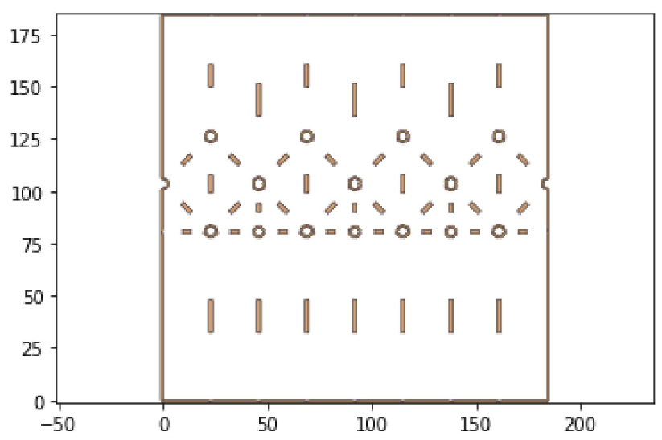
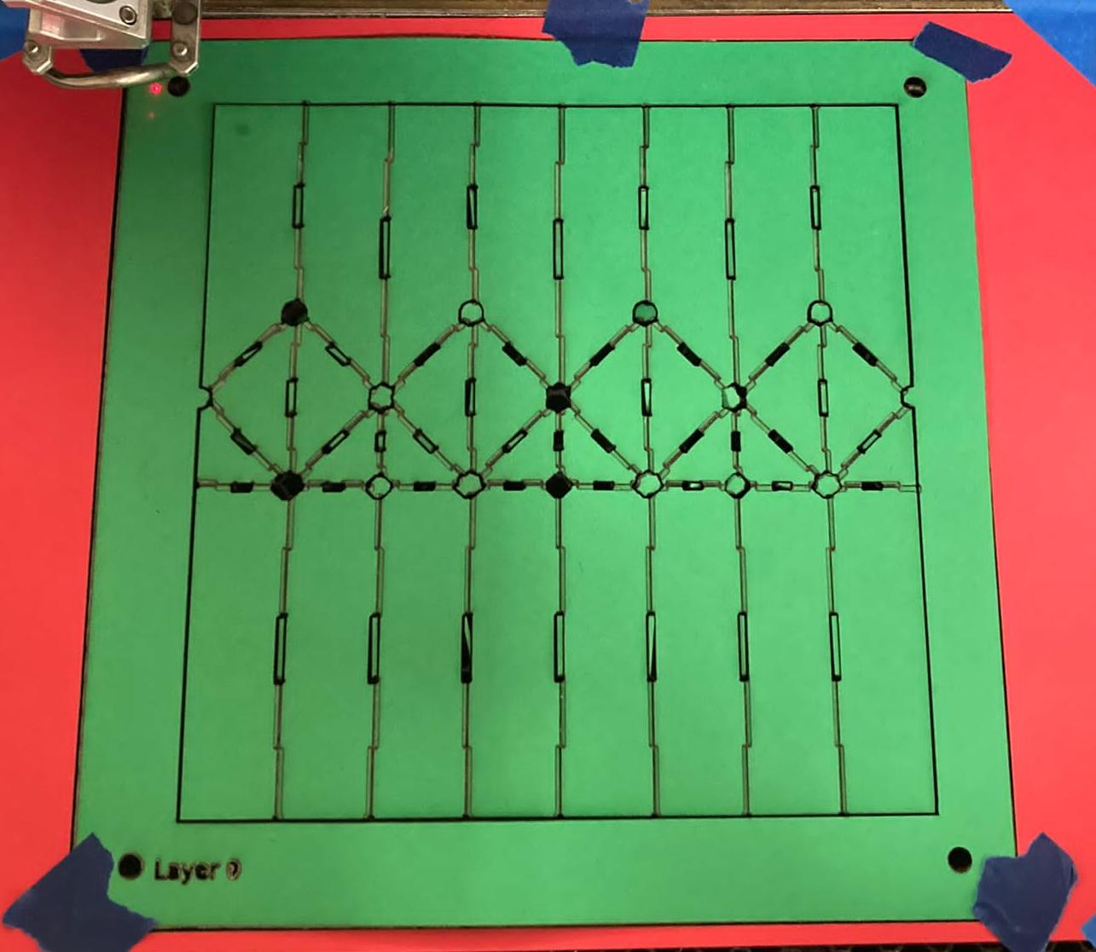
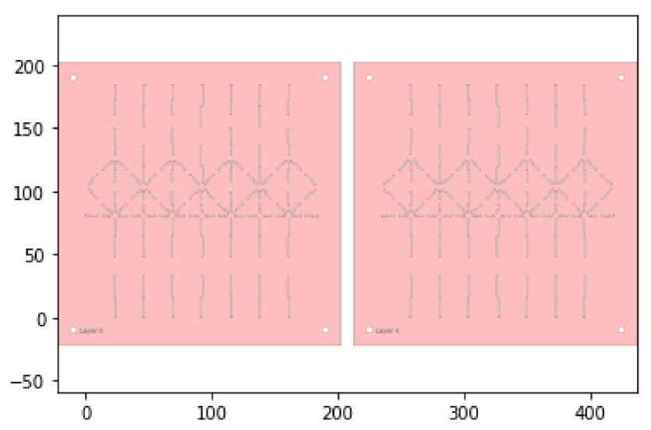
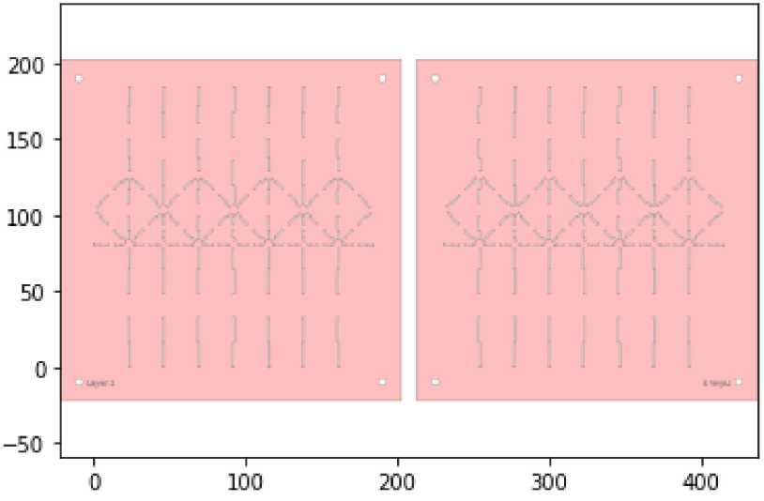
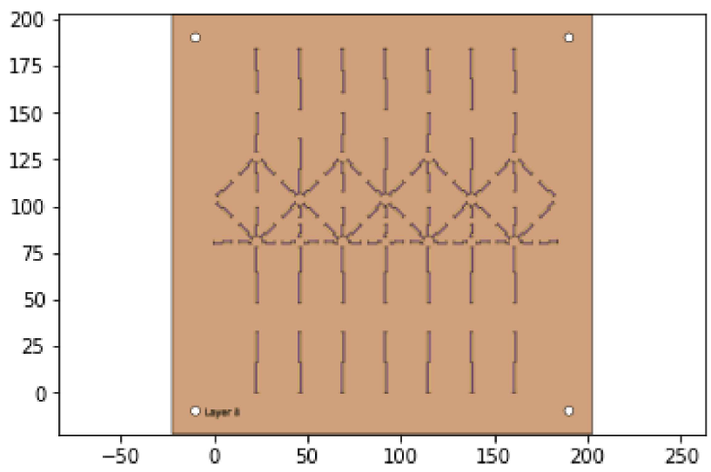
Manufacturing
5 Layer Design:
Project Update
Dynamics
Data Collection, Parameter Identification, and Model Fitting
Manufacturing
Future Plans

Slide 6
Manufacturing Challenges
Challenges faced while manufacturing the first iteration of our prototype:
Experimenting with vector print speed and power values for different materials
Original design was too large to fit on our material sheet
Scaling the design down in the code to align with the pins in the jig
Lamination issues
Selecting an appropriate temperature for lamination
Improper lamination due to unevenness of the heating pad
The final cut
Aligning of cardstock on the Epilog laser to match the position of the dxf cut

Slide 7
Future Plans
1 .We plan to make another prototype of a bigger size using a thinner paper
-We will refine our manufacturing processes
2. Test various motor timings in software
-This will help us refine our locomotion strategy
3. Use software optimization to find the ideal leg end stop angle
This angle can be changed with only a minor change to the leg fold pattern
The use of a different angle may be beneficial to our locomotion strategy
4. Finding out how much load will the system support when there are 4 legs
Project Update
Dynamics
Data Collection, Parameter Identification, and Model Fitting
Manufacturing
Future Plans

Slide 8
References
[1] D. Aukes, “Foldable Robotics Github Repository”, https://foldable-robotics.github.io/

